Slide 1
TSP solution methods

Slide 2
Directed Graph Edge Elimination

Slide 3
In the case of 2 edges, from N to B, we have the following configuration
We know if cost A→N is zero, then N merges into A and N effectively merges into A, creating a merged point, A’. The question is: what if costs A→N are small, but non-zero? Under what conditions can we merge A and N into one point, A’?
B
A
N

Slide 4
This can be reframed: under what conditions will the connection A→N always be the graph connection?
The question really is: everywhere A or N appears, do they ALWAYS appear in sequence?
Ideal, but not required: A→N→X is lower in cost than A→X for all X
All exiting branches use same entrance: Namely: A→N→X is lowest cost for all X, among different N values
All entering branches use same exit: Namely: X→A→N is lowest cost for all X, among different X values
B
A
N
M

Slide 5
The following discussion is motivated by this example Note: this is test case 20001 in script_test_fcn_BoundedAStar_solveTSP
costsFromTo =
-1.0000 24.0684 30.0209 18.9170 31.4222 33.7447 19.1321
7.2562 -1.0000 9.4509 22.0770 16.2501 28.1331 23.0112
22.3262 17.4011 -1.0000 39.1600 14.6604 33.1916 40.1173
9.1356 11.0832 15.5267 -1.0000 17.9549 14.5215 7.6070
31.1272 29.4434 31.0481 23.9177 -1.0000 15.5548 26.6661
19.6909 13.2717 14.5390 29.0153 9.4307 -1.0000 33.3240
11.3292 12.5980 16.5175 1.5768 19.6550 14.0527 -1.0000

Slide 6
A→N→X is lower in cost than A→X for all X

Slide 7
To test for: A→N→X is lower in cost than A→X for all X, we calculate A→N (scalar) and add it to the N→X row. This is then the A→N→X. We then compare the 2 rows A→X and A→N→X
B
From \To | 1 | N | 3 | 4 | 5
1
N |  |  |  |  | N->X row
A→X |  | A→N
4
5
A
N

Slide 8
For A→N→X to be lower in cost than A→X , the bottom row should be always less than the top. In this is example, this is NOT true
But they are very (very) close.
NOTE: we need to examine how close is close enough
disp([fromA; fromNplusFromAtoN])
11.3292 12.5980 16.5175 1.5768 19.6550 14.0527 Inf
10.7124 12.6601 17.1035 Inf 19.5318 16.0983 9.1839

Slide 9
How to test if A→N→X is lowest cost for all X, among different N values
M
B
A
N
C
O
D

Slide 10
If we consider all A→X→B transitions, for all possible values of X, and if the minimum is always A→N→B, then this path is the optimal 2-edge transition from A to X to B
How does one check for this comparison do in relation to the cost matrix?
B
From \To | 1 | N | 3 | 4 | B
1
N |  |  |  |  | N->B
A |  | A→N
4
5
A
N

Slide 11
The sum of the A row, transposed, with the B column in the cost matrix represents all transitions from A to B. The row minimum of this row/col sum will always be the X giving the best A to X to B transition.
B
From \To | 1 | N | 3 | 4 | B
1
N |  |  |  |  | N->B
A |  | A→N
4
5
A
N

Slide 12
Now instead of B, we choose a different point, C. Again, we can check if A→N→C is minimum. We can repeat over all X to see if the row-minimum for all possible A→N→X variations
B
From \To | C | N | 3 | 4 | B
1
N | N->C
A |  | A→N
4
5
A
N
C

Slide 13
This A→N→X test is the A-row, transpose, added to the whole matrix. If the Nth row is always the column minimum, then this minimum row (N) is always the least-cost 2-edge path from the source row (A).
B
From \To | C | N | 3 | 4 | B
1
N | N->C
A |  | A→N
4
5
A
N
C

Slide 14
7 to 4 to X transition test shows that 4th row is always least
costsFromTo =
-1.0000 24.0684 30.0209 18.9170 31.4222 33.7447 19.1321
7.2562 -1.0000 9.4509 22.0770 16.2501 28.1331 23.0112
22.3262 17.4011 -1.0000 39.1600 14.6604 33.1916 40.1173
9.1356 11.0832 15.5267 -1.0000 17.9549 14.5215 7.6070
31.1272 29.4434 31.0481 23.9177 -1.0000 15.5548 26.6661
19.6909 13.2717 14.5390 29.0153 9.4307 -1.0000 33.3240
11.3292 12.5980 16.5175 1.5768 19.6550 14.0527 -1.0000
ArowPlusMatrix =
Inf 35.3976 41.3501 30.2462 42.7514 45.0739 30.4613
19.8541 Inf 22.0489 34.6750 28.8481 40.7310 35.6092
38.8436 33.9186 Inf 55.6775 31.1779 49.7090 56.6347
10.7124 12.6601 17.1035 Inf 19.5318 16.0983 9.1839
50.7822 49.0983 50.7031 43.5727 Inf 35.2098 46.3211
33.7436 27.3243 28.5917 43.0679 23.4833 Inf 47.3767
Inf Inf Inf Inf Inf Inf Inf

Slide 15
Now, check that X→A→N is lowest cost 2-step transition for all X connecting to N, among different X values
M
B
A
N
O
C
D

Slide 16
If we consider all M→X→N transitions, for all possible values of X, and if the minimum is always M→A→N, then this path is the optimal 2-edge transition from M to N
This looks a bit like the previous calculation, but reversed, since A and N are known but B is unknown. Let’s start with source M
From \To | 1 | A | 3 | 4 | N
1
A |  |  |  |  | A->N
3
M |  | M→A
5
M
B
A
N
O
C
D

Slide 17
The column under N is the cost to go from X to N. If we transpose that into a row, and add it to the M row, the result is the costs from M to X to N
If A is the lowest-cost column, then A is the best 2-edge transition from M to N.
From \To | 1 | A | 3 | 4 | N
1
A |  |  |  |  | A->N
3
M |  | M→A
5
M
B
A
N
O
C
D

Slide 18
This gives the process to check for the general X→A→N transition. Namely, take the N column, transpose, and add it row-wise to entire cost matrix. If the minimum column is always A, then X→A→N is always the best 2-edge transition from everything
From \To | 1 | A | 3 | 4 | N
1
A |  |  |  |  | A->N
3
M |  | M→A
5
M
B
A
N
O
C
D

Slide 19
X to 7 to 4 transition test. ALMOST all transitions satisfy
costsFromTo =
-1.0000 24.0684 30.0209 18.9170 31.4222 33.7447 19.1321
7.2562 -1.0000 9.4509 22.0770 16.2501 28.1331 23.0112
22.3262 17.4011 -1.0000 39.1600 14.6604 33.1916 40.1173
9.1356 11.0832 15.5267 -1.0000 17.9549 14.5215 7.6070
31.1272 29.4434 31.0481 23.9177 -1.0000 15.5548 26.6661
19.6909 13.2717 14.5390 29.0153 9.4307 -1.0000 33.3240
11.3292 12.5980 16.5175 1.5768 19.6550 14.0527 -1.0000
NcolPlusMatrix =
Inf 46.1454 69.1809 Inf 55.3400 62.7600 20.7089
26.1732 Inf 48.6110 Inf 40.1678 57.1483 24.5880
41.2432 39.4782 Inf Inf 38.5781 62.2068 41.6941
28.0526 33.1603 54.6867 Inf 41.8726 43.5367 9.1839
50.0442 51.5204 70.2081 Inf Inf 44.5701 28.2429
38.6079 35.3487 53.6991 Inf 33.3484 Inf 34.9008
30.2462 34.6750 55.6775 Inf 43.5727 43.0679 Inf

Slide 20
Looking at the one that does not, it suggest that 3→7→4 is not as good as 3→5→4 or 3→2→4. Of note, this option is VERY close to the max (within 5%) and the max value is very high relative to others (indeed, highest).
NcolPlusMatrix =
Inf 46.1454 69.1809 Inf 55.3400 62.7600 20.7089
26.1732 Inf 48.6110 Inf 40.1678 57.1483 24.5880
41.2432 39.4782 Inf Inf 38.5781 62.2068 41.6941
28.0526 33.1603 54.6867 Inf 41.8726 43.5367 9.1839
50.0442 51.5204 70.2081 Inf Inf 44.5701 28.2429
38.6079 35.3487 53.6991 Inf 33.3484 Inf 34.9008
30.2462 34.6750 55.6775 Inf 43.5727 43.0679 Inf

Slide 21
Let’s see if we could have predicted the solution!
FINAL RESULTS:
Number of cities (goals, no start): 6
Wall time: 0.057 seconds
Solution sequence: 1 7 4 3 5 6 2 1
Number of main loop iterations: 222
Number of staged tests checked: 482
Number of staged tests: 484

Slide 22
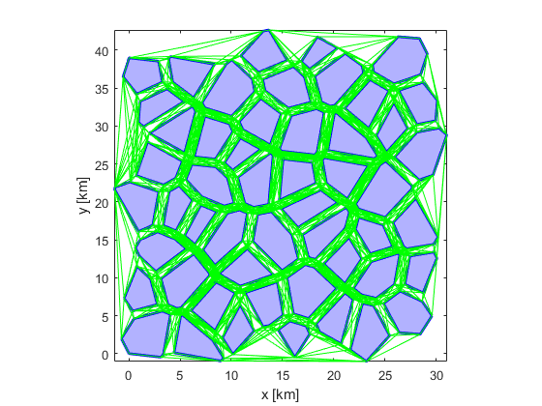
The A* toolbox can handle generation of both simple and complex visibility graphs

Slide 23
Visibility graph modification tools allow easy removal or addition of obstacles from a map

Slide 24
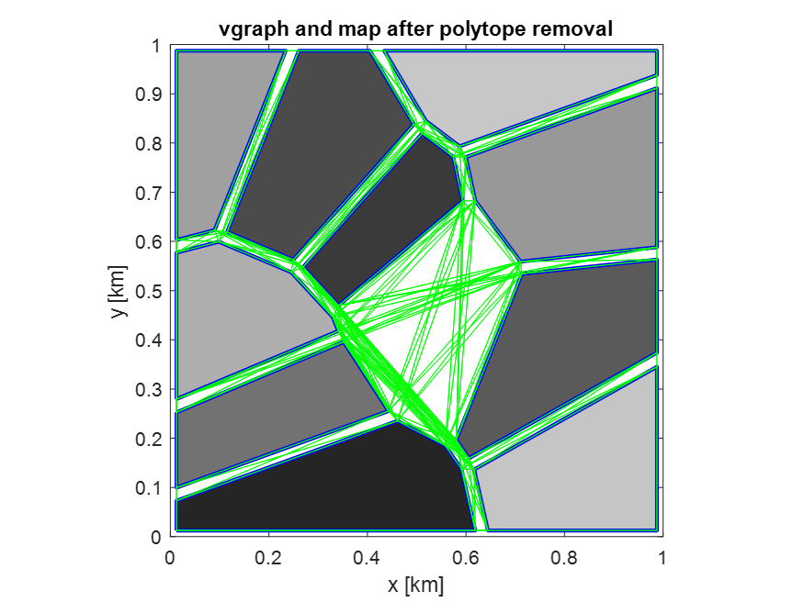
Visibility graph modification tools allow easy removal or addition of obstacles from a map

Slide 25
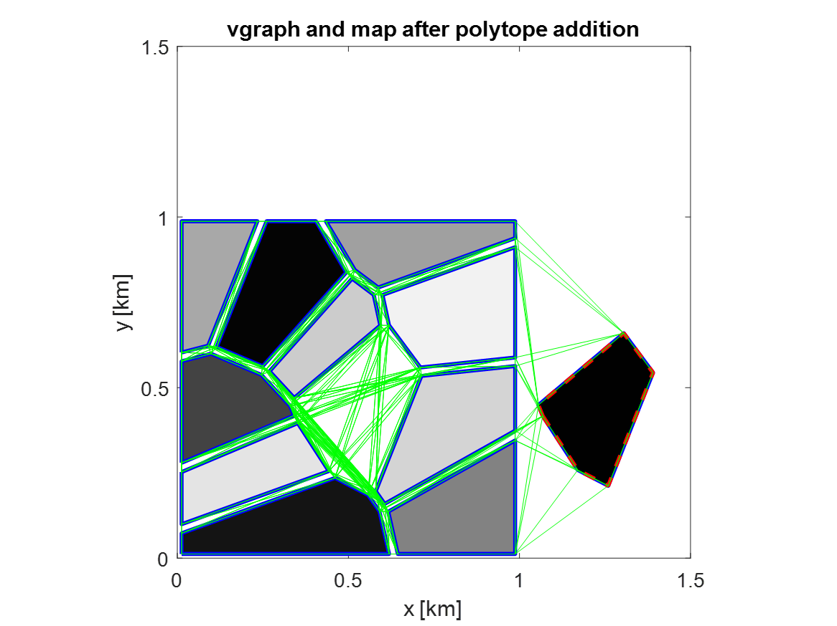
Visibility graph modification tools allow easy removal or addition of obstacles from a map

Slide 26
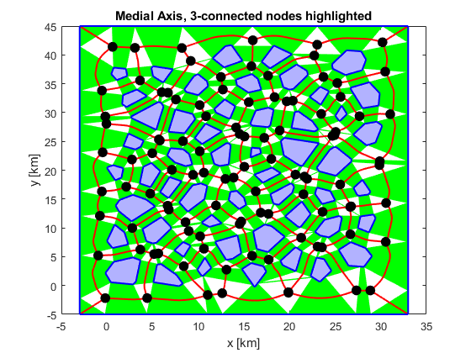
The medial axis graph is created by triangulating the free space to find the path in the middle of two obstacles

Slide 27
Medial axis graphs have significantly fewer nodes than visibility graphs, making them good for use in denser obstacle fields

Slide 28
Path Planning Tools

Slide 29
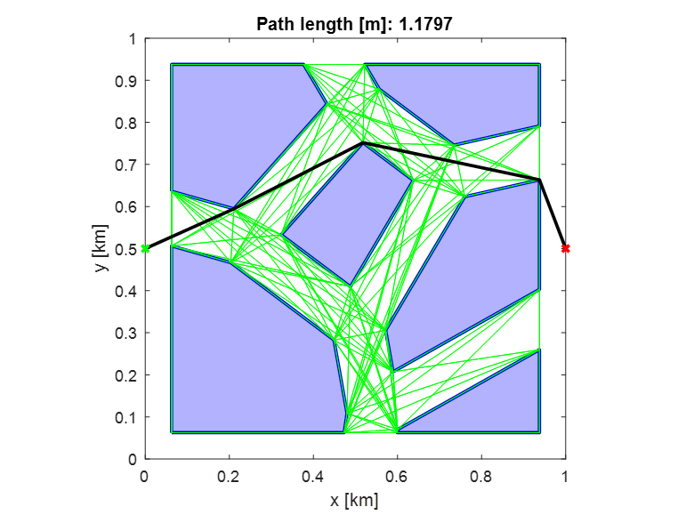
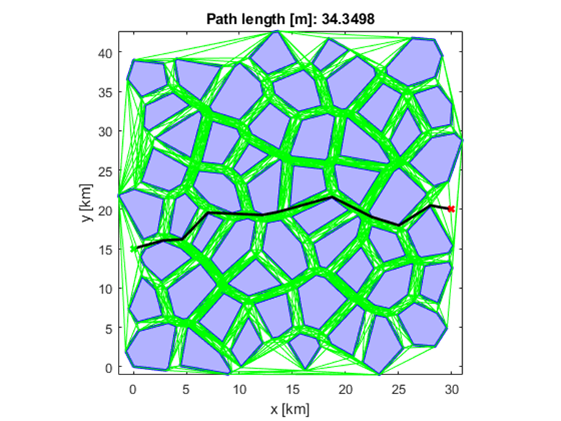
A* path planning on generated visibility graphs

Slide 30
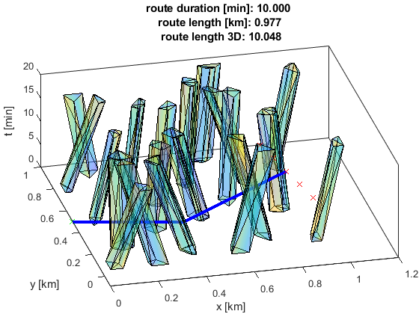
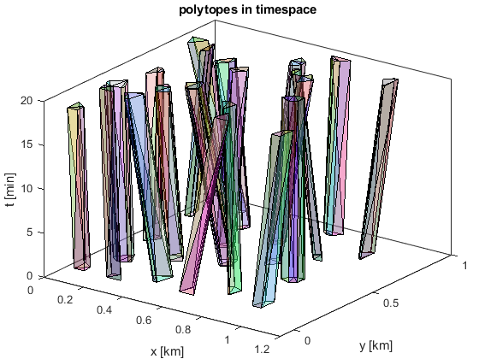
The 3d version of the A* planner can work in timespace to intercept a goal on a trajectory

Slide 31
Planner behavior can be modified by changing what the cost function penalizes
shorter path segments in narrow corridors
longer path segments in more open areas

Slide 32
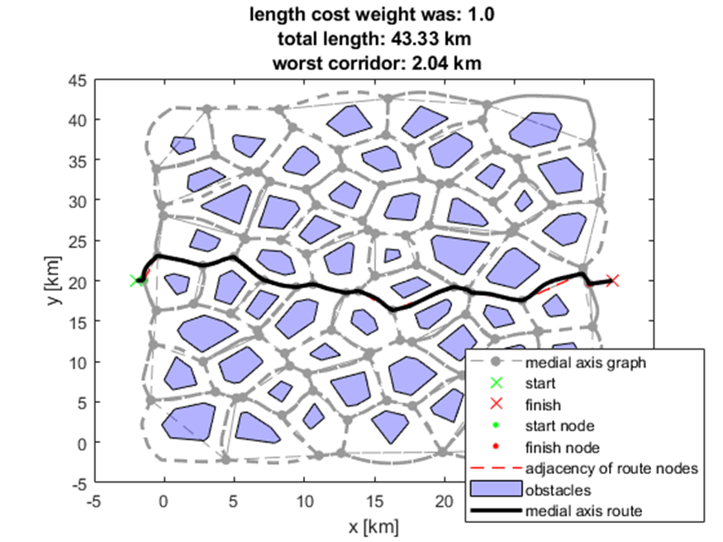
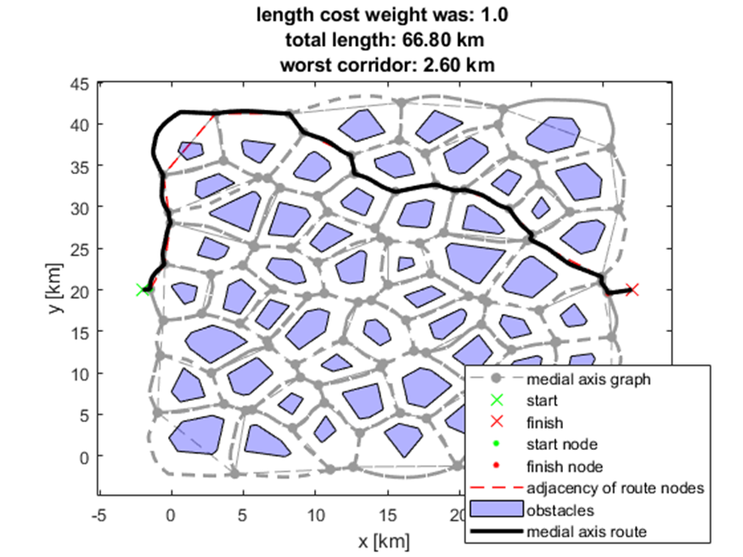
Planner behavior can be modified by changing what the cost function penalizes

Slide 33
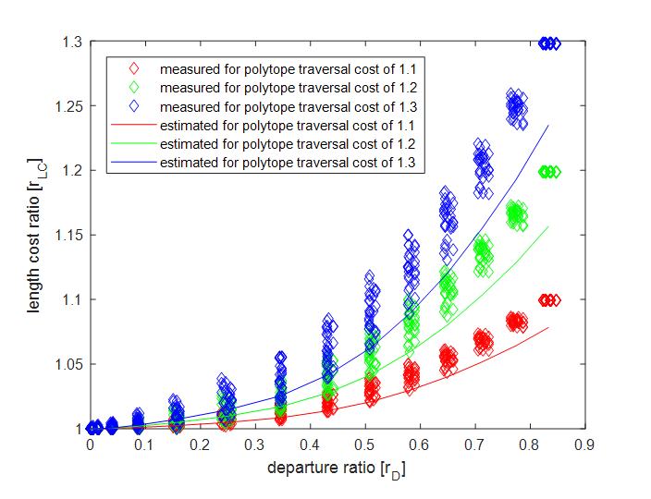
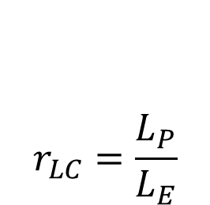
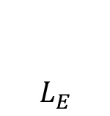
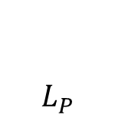
The length cost ratio estimates length navigation cost in a map without actually planning a path
$$r_{LC}=\frac{L_{P}}{L_{E}}$$
$$L_{P}$$
Estimated total path length
from start to goal
$$L_{E}$$
- distance from start to goal

Slide 34
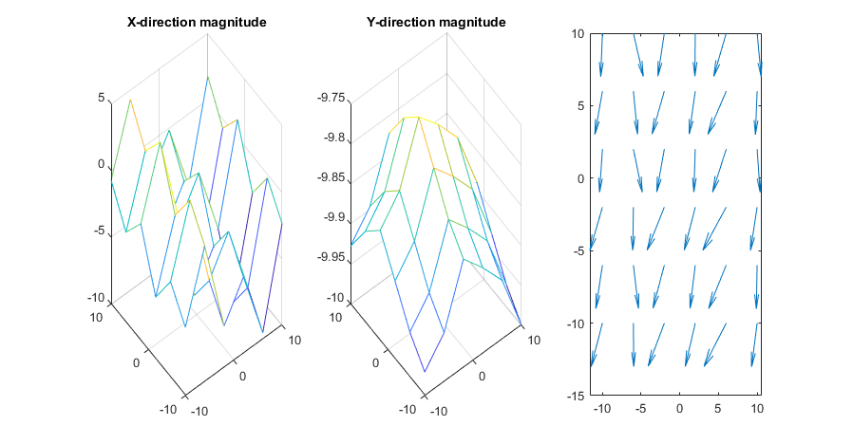
WIP: Wind field representation to be incorporated into cost

Slide 35


Questions?
sites.psu.edu/pangborn

Slide 36
Place highlights here.
Highlight details here.

